Slide 1
ACQUIRE. PRESERVE. APPRECIATE.
GUCCI COLLECTION FUND I
An independently managed alternative-asset fund focused on acquiring, managing,
and monetizing investment-grade Gucci-designed luxury handbags.
Managed by ApodcStore Mgt. This fund is independently managed and is not affiliated with, sponsored by, or endorsed by Gucci, Kering S.p.A., or any of their affiliates.

Slide 2
Executive Summary
Gucci Collection Fund I is a private investment vehicle offering exposure to one of the fastest-emerging alternative asset categories: investment-grade luxury handbags.
The Fund acquires carefully selected Gucci-designed handbags with strong resale demand and appreciation potential and pursues multiple monetization channels designed to generate both capital appreciation and recurring income.
Investors gain professionally managed exposure without the sourcing, authentication, storage, or resale burden of building a collection independently.
18 Month
10–13%
Target Investment
Horizon
Preferred
Return
Targets are objectives only and are not guaranteed. See Risk Factors.
GUCCI COLLECTION FUND I | CONFIDENTIAL
2

Slide 3
Investment Thesis
Luxury is no longer simply consumed — it is collected.
1
Global brand recognition
2
Limited production supply
3
Strong secondary resale demand
4
High liquidity vs. other collectibles
5
Historical inflation resilience
6
Cross-border market accessibility
GUCCI COLLECTION FUND I | CONFIDENTIAL
3

Slide 4
Why Now
1
2
Luxury Resale Market Expansion
Digital Authentication
Growing consumer participation continues increasing liquidity across premium resale platforms.
Technology has improved buyer confidence through professional authentication and verification.
3
4
Global Demand
Limited Production
Luxury demand continues expanding across North America, Europe, the Middle East, and Asia.
Scarcity remains one of the strongest drivers of long-term pricing.
GUCCI COLLECTION FUND I | CONFIDENTIAL
4

Slide 5
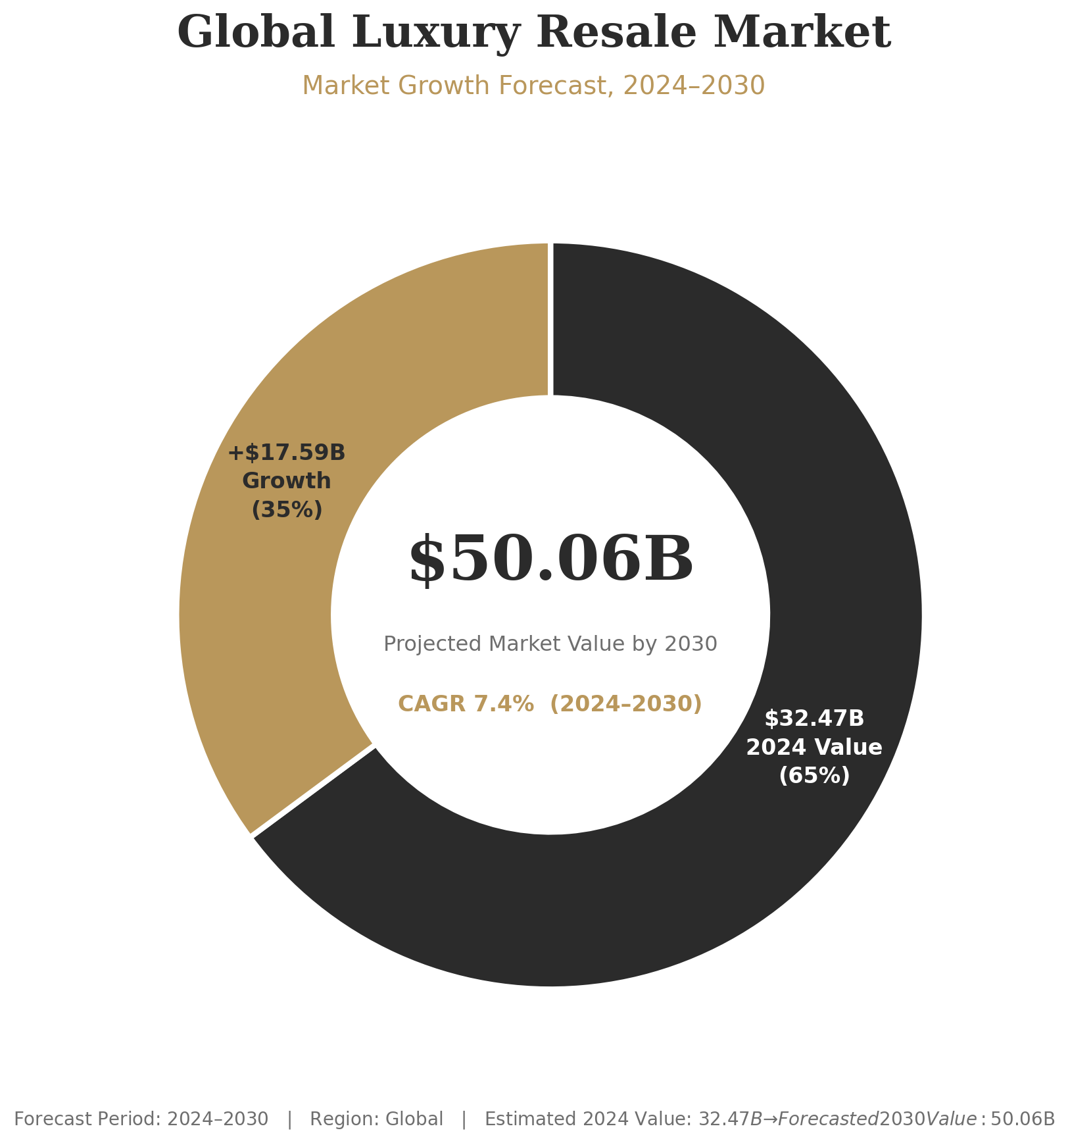
Structural tailwinds cited in this thesis:
Resale platforms expanding buyer/seller liquidity
Authentication technology reducing counterfeit risk
Cross-border demand across multiple regions
Constrained production supporting scarcity value
GUCCI COLLECTION FUND I | CONFIDENTIAL
5

Slide 6
Investor Return Strategy
Returns are targeted through five potential channels — not all channels will apply to every asset.
Capital Appreciation:
Strategic appreciation of selected handbags over the holding period.
1
Secondary Market Sales
Disposition through established luxury resale channels.
2
International Distribution
Wholesale opportunities through global luxury buyers.
3
Private Collector Transactions
Direct sales to qualified individual collectors.
4
Luxury Rental Programs
Premium rental income generated from selected inventory.
5
GUCCI COLLECTION FUND I | CONFIDENTIAL
6

Slide 7
Portfolio Construction
Illustrative target allocation —actual acquisition targets may change based on market demands and investors portfolio is defined
Limited Edition Gucci Bags
Constrained-run releases with elevated resale premiums.
Iconic Collections
Long-running signature lines with proven demand history.
Seasonal High-Demand Releases
Runway and capsule pieces with near-term liquidity.
Collector Editions & Rare Vintage
Scarcity-driven pieces held for longer appreciation cycles.
GUCCI COLLECTION FUND I | CONFIDENTIAL
7

Slide 8
Fund Terms
Fund Name | Gucci Collection Fund I
Manager | ApodcStore Mgt
Asset Class | Gucci-Designed Luxury Handbags
Strategy | Acquisition, Appreciation & Resale
Investment Horizon | 18 Months
Preferred Return | 10 – 13%
Distribution | Monthly
Payout | Return at Fund Closing {initial investment}
New Investors | Open to New Investors
Minimum Buying Units | [ 699 MBU | Priced $72 Per Unit ]
Management Fee | [ 1% Fee ] At closing of the fund payout
Staring at $50,328 to add to your portfolio. Gucci Collection Fund I.
GUCCI COLLECTION FUND I | CONFIDENTIAL

Slide 9
Fund Terms
Fund Name | Gucci Collection Fund I
Manager | ApodcStore Mgt
Asset Class | Gucci-Designed Luxury Handbags
Strategy | Acquisition, Appreciation & Resale
Investment Horizon | 18 Months
Preferred Return | 10 – 13%
Distribution | Monthly
Payout | Return at Fund Closing {initial investment}
New Investors | Open to New Investors
Minimum Buying Units | [ 101 MBU ]
Management Fee | [ 1% Fee ] At closing of the fund payout
Staring at $2,828 to add to your portfolio. Gucci Collection Fund.

Slide 10
Risk Management & Risk Factors
Institutional Controls
Key Risk Factors
Illiquidity — sale timing and pricing in secondary/resale markets are not guaranteed
Professional authentication of every acquisition
Diversified acquisitions across collections
Authentication & counterfeit risk on any acquired asset
Insurance coverage on the full portfolio
Single-brand concentration risk (no diversification across designers)
Climate-controlled, secure storage
Resale price volatility tied to shifting consumer demand and trends
Market pricing analytics
Key-person risk — reliance on the Manager's acquisition and disposition judgment
Independent valuation reviews
No guarantee that target or preferred returns will be achieved
GUCCI COLLECTION FUND I | CONFIDENTIAL

Slide 11
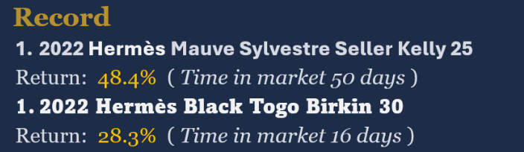
Management
About ApodcStore Mgt
ApodcStore specializes in sourcing, authenticating, managing, and monetizing premium luxury investment assets through disciplined acquisition strategies and data-driven market analysis. The platform combines luxury expertise, resale intelligence, authentication standards, and portfolio management to create institutional access to a growing alternative investment sector.
Named principals: Mithcy May oversees the Gucci Collection Fund for ApodcStore MGT, leveraging deep market expertise to curate high-end alternative investments and deliver exceptional fractional ownership value. (mitchy.may@apodcstore.com)
Prior track record — deals completed, realized returns, holding periods: Past Performance
Large Gucci Mega Web duffle bag
Return: 28.4% (Time in market 45 days)
Gucci Paparazzo Medium Top Handle Bag
Return: 22.6% (Time in market 36 days)
GUCCI COLLECTION FUND I | CONFIDENTIAL
11

Slide 12
Luxury has evolved into an investable asset class.
Gucci Collection Fund I offers professionally managed exposure to premium luxury handbags through a disciplined acquisition, management, and monetization strategy — combining authentication expertise and institutional asset-management practices.
We believe the convergence of brand scarcity, expanding resale infrastructure, and sustained global demand creates a compelling window for disciplined, professionally managed acquisition — and we invite qualified investors to be part of that opportunity from the ground up.
CONTACT
ApodcStore
Investor Relations: ir@apodcstore.com
LEGAL DISCLOSURES
This material is for informational purposes only and does not constitute an offer to sell or a solicitation of an offer to buy any securities, investment, legal, or tax advice. Any such offer will be made only by means of a Confidential Private Offering Memorandum and applicable subscription documents. Participation is subject to investor qualification requirements and applicable law.
Investments involve risk, including possible loss of principal. Target and preferred returns are objectives only and are not guaranteed. Luxury asset values fluctuate based on market conditions, consumer demand, rarity, condition, authenticity, and broader economic factors. Past performance does not guarantee future results.
Gucci Collection Fund I is independently managed by ApodcStore Mgt. Gucci does not sponsor, endorse, authorize, or have any affiliation with ApodcStore, Gucci Collection Fund I, or their affiliates.

